Slide 1

ANALYSIS OF HISTORICAL PHYSICAL VIDEO GAME SALES TO HELP
UNDERSTAND FUTURE TRENDS
Ha Nul Ryou,
Jatinder Midha
Avi Kumar
Wei-Hsin Liu
Ting-I Lin
Jingqi Zhang ANLY 545
AUGUST 2019 | CONFIDENTIAL

Slide 2
Introduction / Project Overview
Process & Background & Summary
Data & Results
Future
Lessons Learned

Slide 3
INTRODUCTION

Slide 4
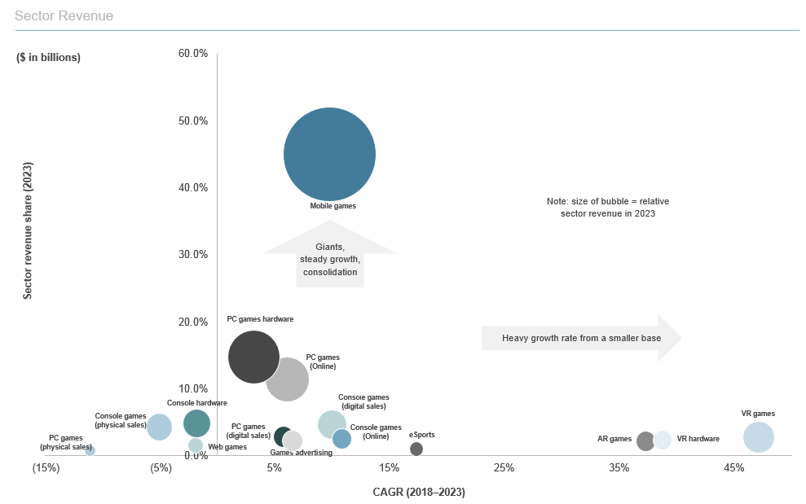
INTRODUCTION
Massive growth in video game sales since 1980s
Big industry
Rapidly evolving
eSports
Gambling
Consolidation

Slide 5
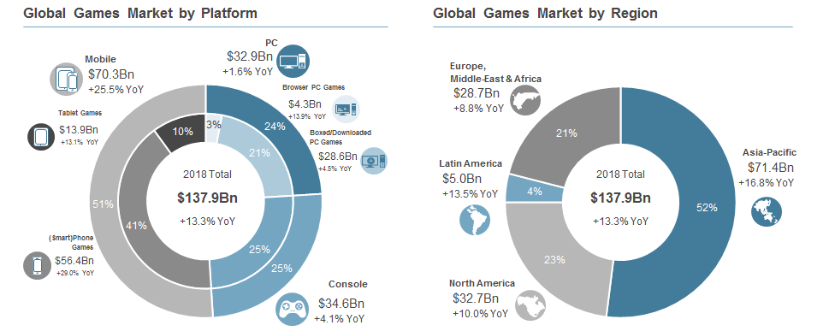
INTRODUCTION (cont.)
Growth in mobile is far outpacing console and PC platforms; mobile games spending increased to $70Bn in 2018 (26% YoY growth)
Mobile is the largest games platform, currently accounts for 51% of total global gaming spend
China, Japan and South Korea account for nearly half of all global games revenue in 2018

Slide 6
PROJECT OVERVIEW
Three major video game publishers in the market during 1980s
Atari (USA)
Activision (USA)
Nintendo (Japan)
The video game PHYSICAL sales industry’s growth started around 1980 until early 2010
Physical Industry sales started to decline, but eSports / mobile exploding
Micro-transactions
Multiplayer mode
User experience

Slide 7
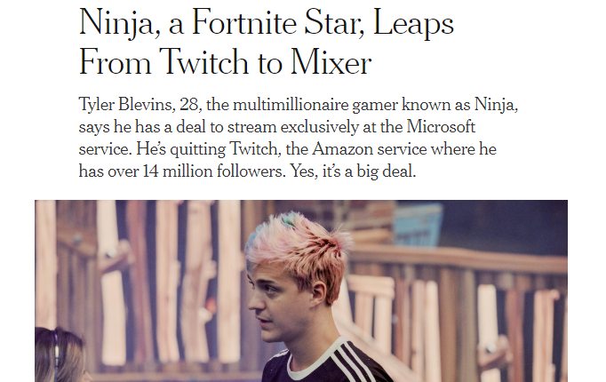
CHALLENGE
Run ANOVA analysis to test different game sales in different territories from historical sales to find variations to see if the impacts are different to predict what types of games / genres / regions do well since the industry has become the number one media and entertainment industry in the world

Slide 8
PROCESS / BACKGROUND & SUMMARY

Slide 9
THE PROCESS
Worked as a team to find interesting data that we were passionate about
Found large dataset with good data and created hypothesis
Cleaned data
Used RStudio
Produced results
Divided into sections

Slide 10
DATA & RESULTS

Slide 11


DATA
The data was discovered on Kaggle database. The data was generated by a data scrape of vghcartz.com which is a video game sales tracking website that provides weekly sales figures of console software and hardware by region. The data contains a list of video games with sales greater than 100,000 copies.

Slide 12
Variables
Rank - Ranking of overall sales
Platform - Platform of the games release (i.e. PC,PS4, etc.)
Genre - Genre of the game
Publisher - Publisher of the game
NA_Sales - Sales in North America (in millions)
EU_Sales - Sales in Europe (in millions)
JP_Sales - Sales in Japan (in millions)
Other_Sales - Sales in the rest of the world (in millions)
Global_Sales - Total worldwide sales.

Slide 13
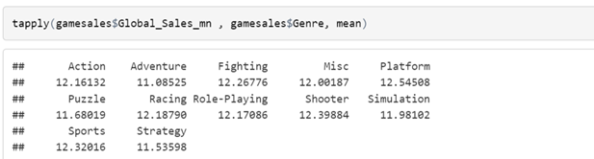
Mean Analysis - Genre
Mean global sales among different genres was actually very close
There is not a lot of variation in our data in the genre variable

Slide 14
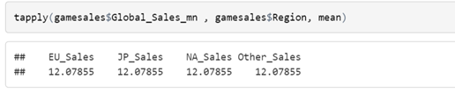
Mean Analysis - Region
There was not a lot of variation in terms of regions

Slide 15
Data Exploratory/Charts
Data Cleaning
Eliminate Year 2017, 2020, and NA data
Reason: data collection till 2016
Converting the Year of Release, Global Sales, and User Score to numeric values
Themes and colors are defined for future charts

Slide 16
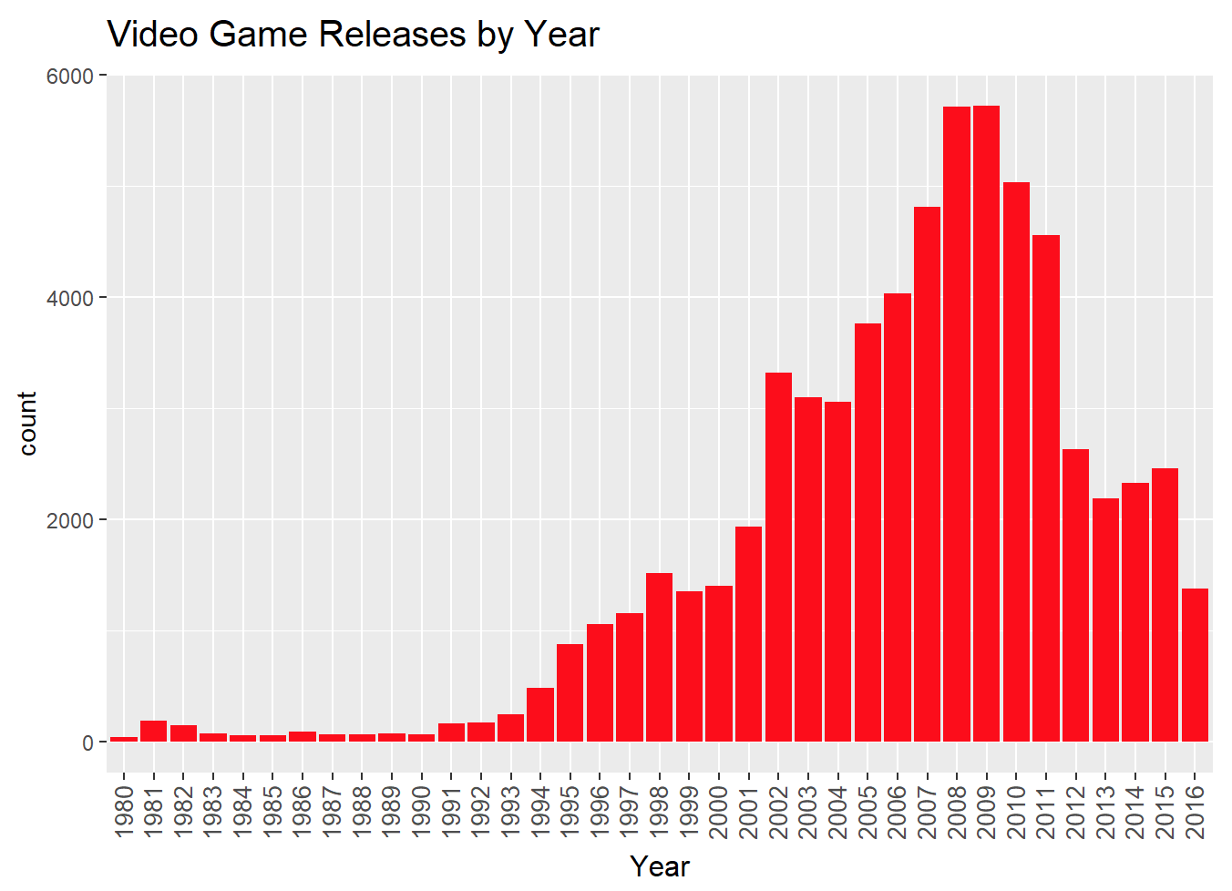
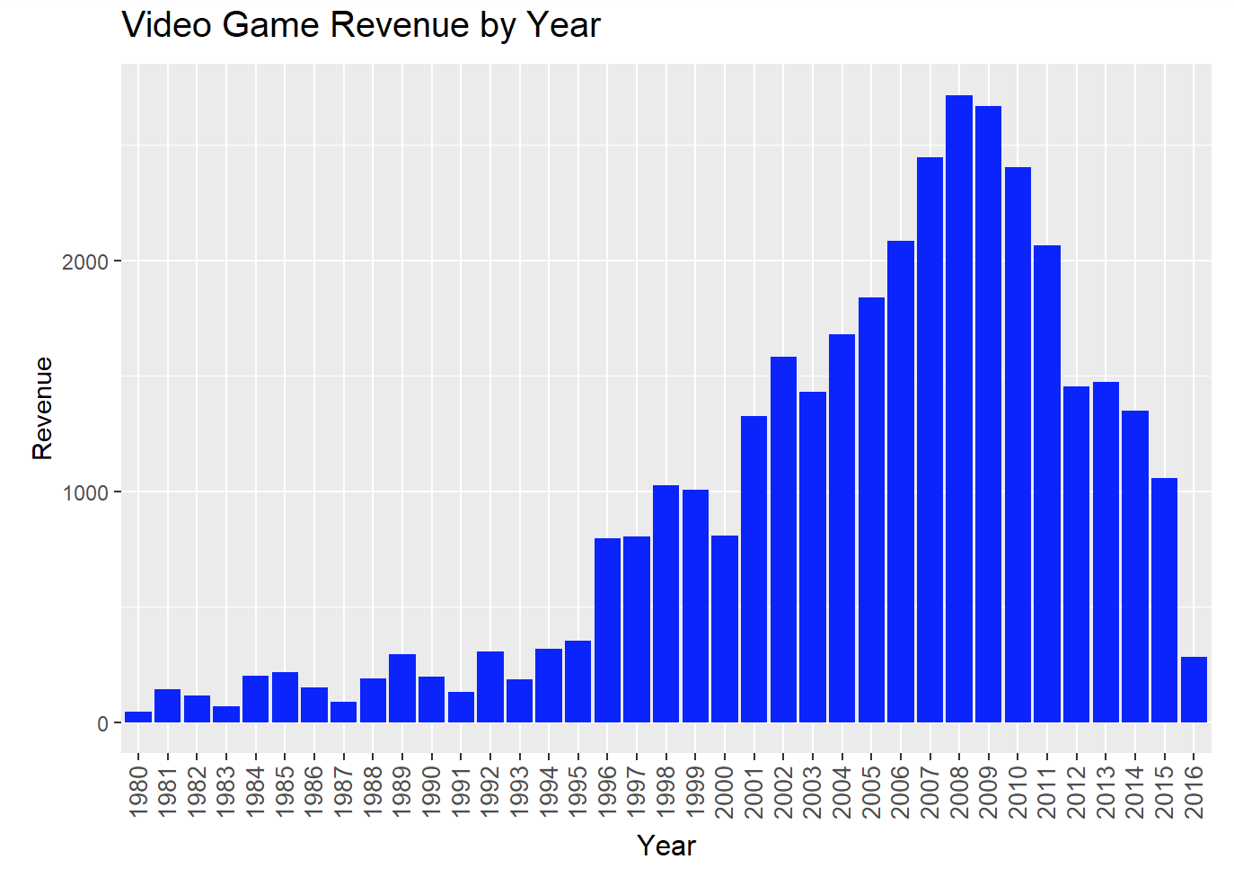
Number of Release by Year / Revenue by Year

Slide 17
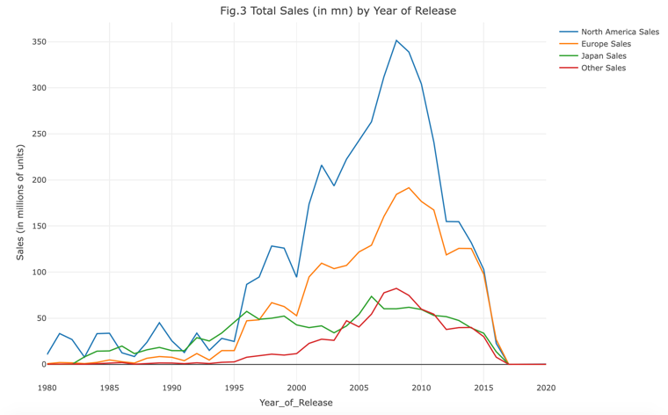
Sales by Year in each Region
xxxxx

Slide 18
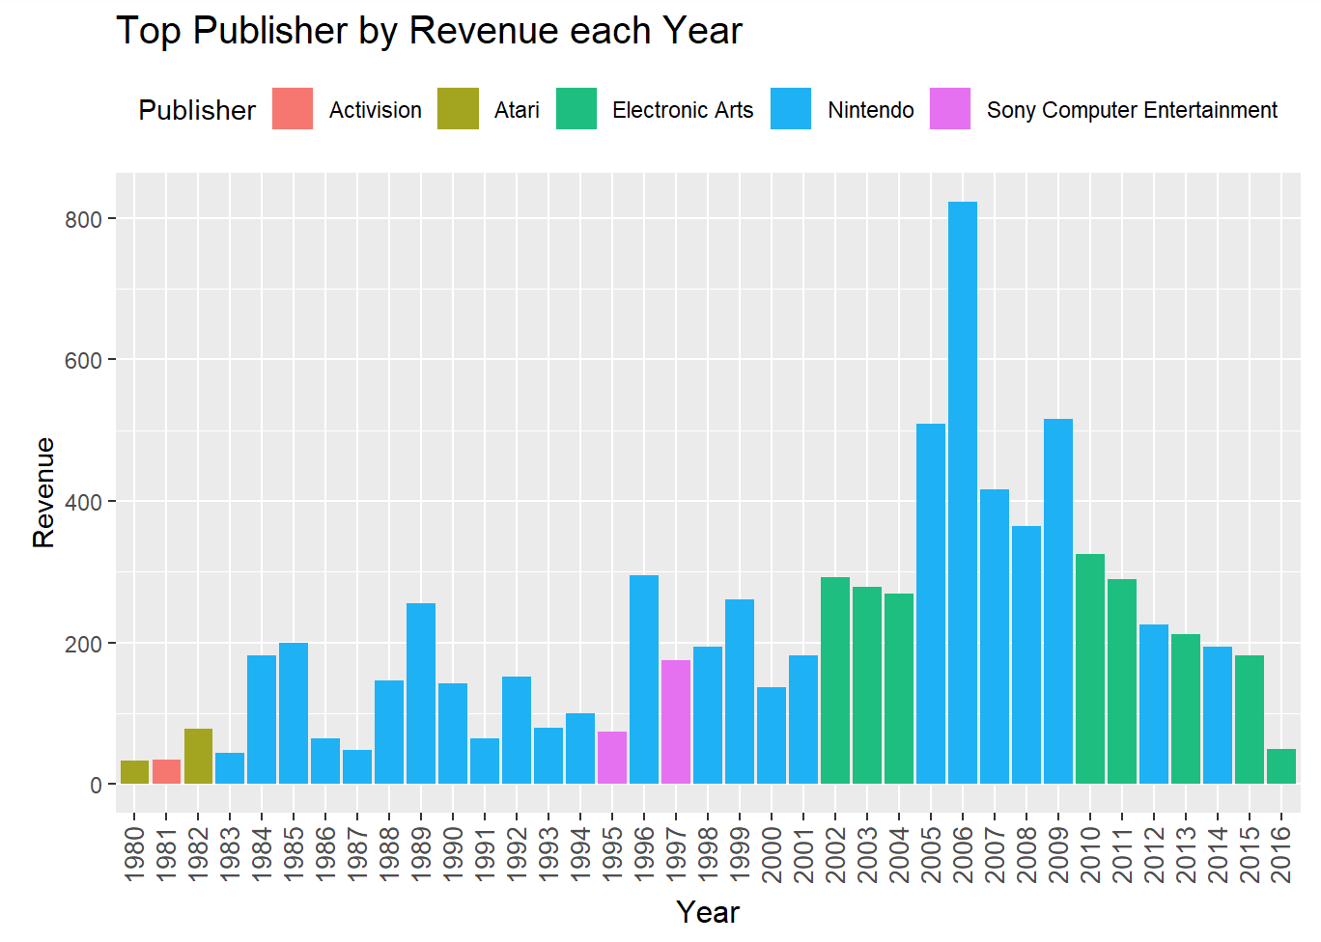
Top Publisher by Revenue per Year

Slide 19
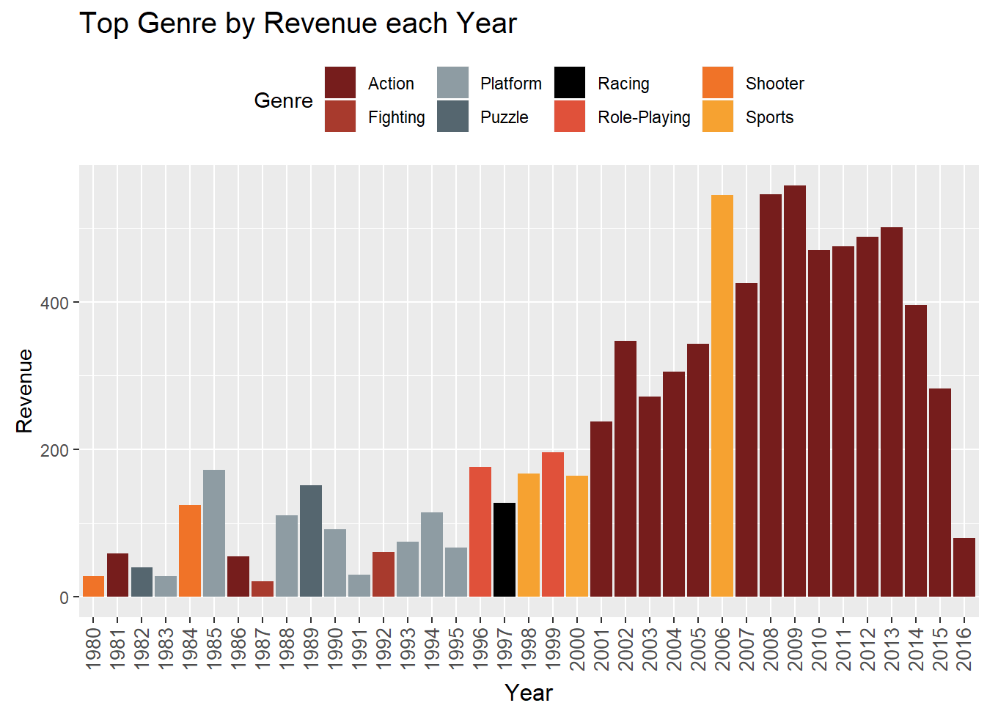
Top Genre by Revenue per Year

Slide 20
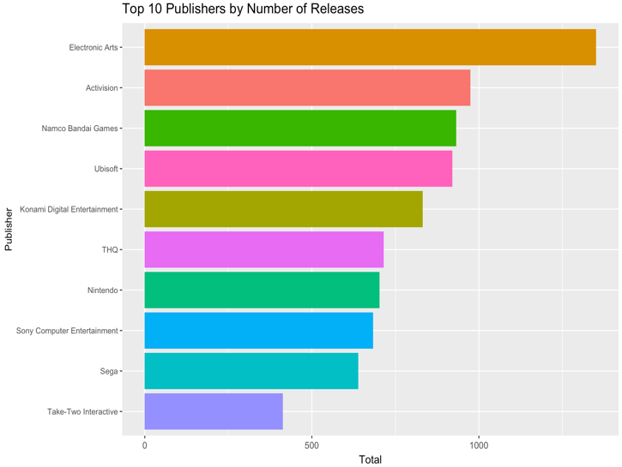
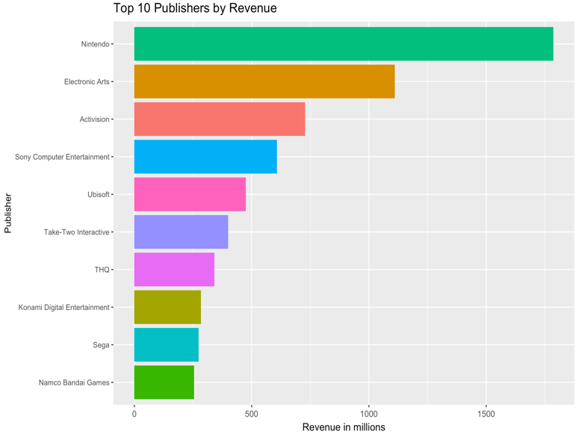
Top 10 Publishers by Number of Releases / by Revenue

Slide 21
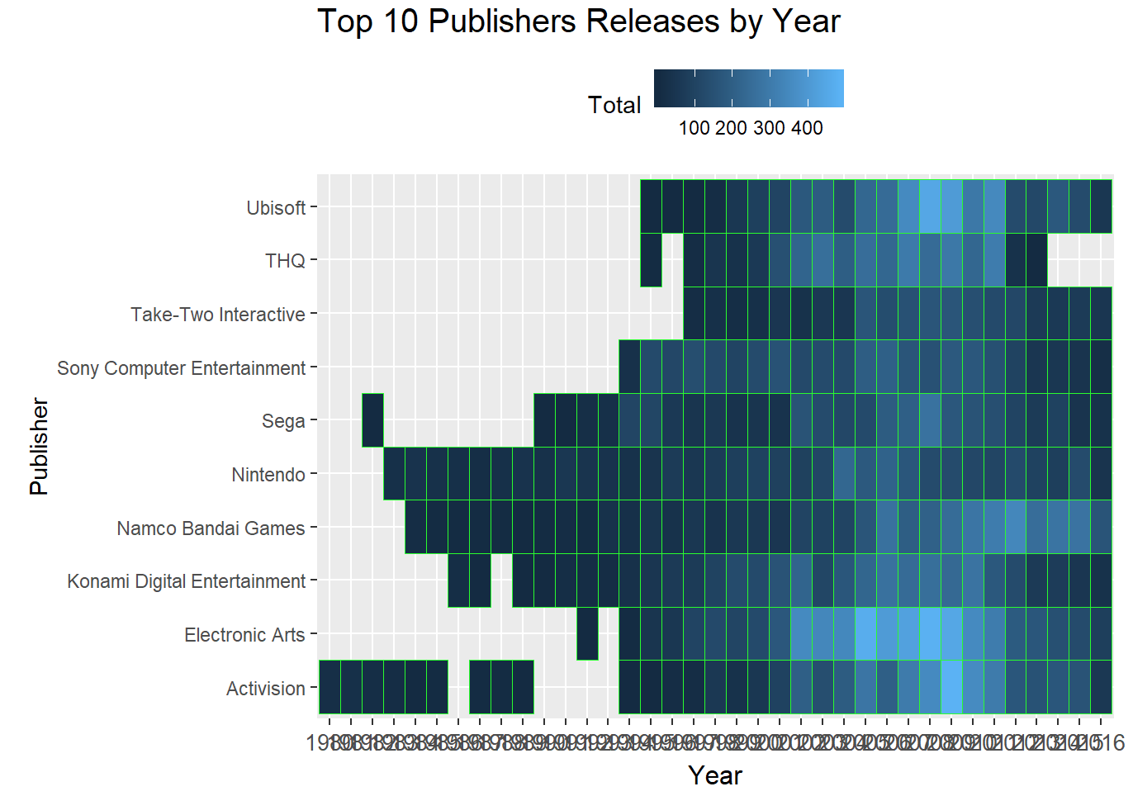
Top 10 Publishers’ Number of Releases by Year

Slide 22
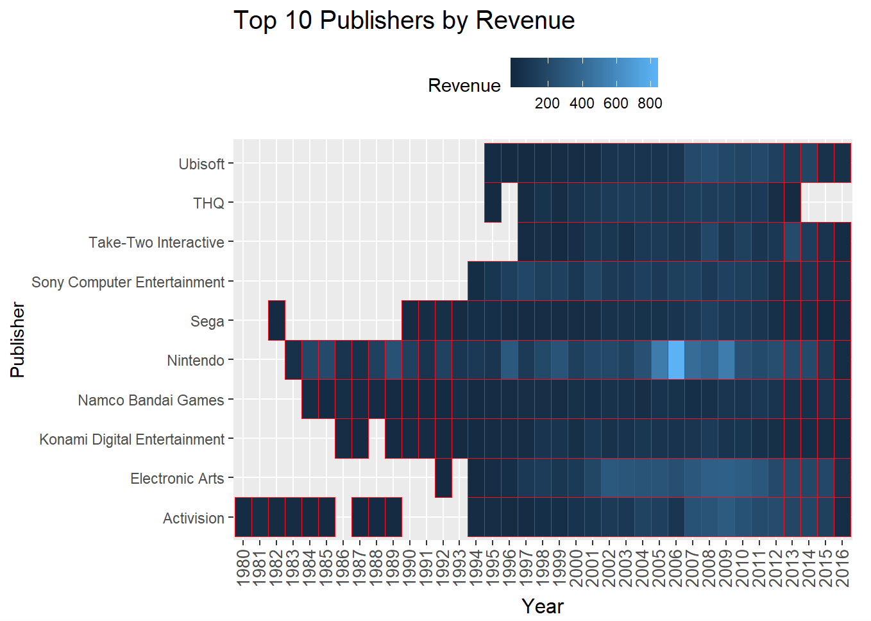
Top 10 Publishers’ Revenue by Year

Slide 23
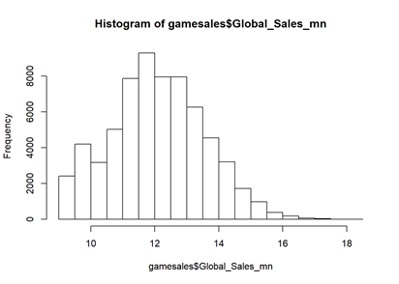
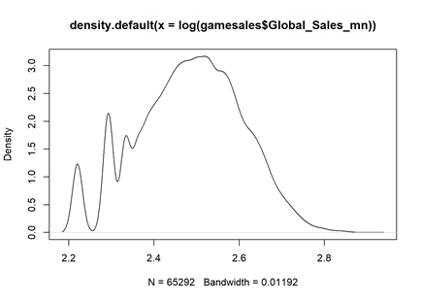
Normal Distribution of Global Sales
Mean global sales of video game : $12.08 million
Minimum global sales : $9.21 million
Maximum global sales : $ 18.23 million.

Slide 24
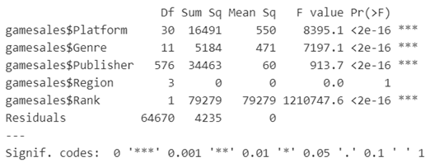
ANOVA Model
Dependent variable: Global sales of video game
Independent variables : Video game platform, Genre, Publisher, Region, and Ranking

Slide 25
FUTURE

Slide 26
FUTURE EFFORTS
Find data on electronic downloads / mobile and compare and contrast
Break down games between casual, midcore, hardcore
Analyse microtransactions
Explore if eSports is correlated with video game sales

Slide 27
LESSONS LEARNED
Nintendo was the leading company in video game market, which can be used as a benchmark
Action was the top genre video game that generated most revenue out of other genre
North America had highest video game sales volume

Slide 28
REFERENCES
(n.d.). Retrieved from https://www.nintendo.com/corp/history.jsp
Is the Video Game Industry Dying? (2018, November 17). Retrieved from https://www.darkspawngaming.com/is-the-video-game-industry-dying/
8 Reasons The Video Game Industry Is Going To Crash Again. (n.d.). Retrieved from https://www.fraghero.com/8-reasons-the-video-game-industry-is-going-to-crash-again/

Slide 29
END

